Slide 1
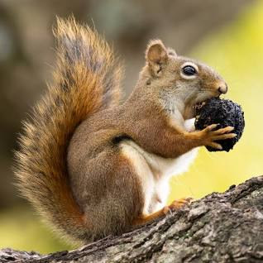
Post-Quantum Cryptography: SQUIRRELS
Names: Al Fahim, Jaraad Hussain, Leonardo Yeung, Daymon Wu

Slide 2
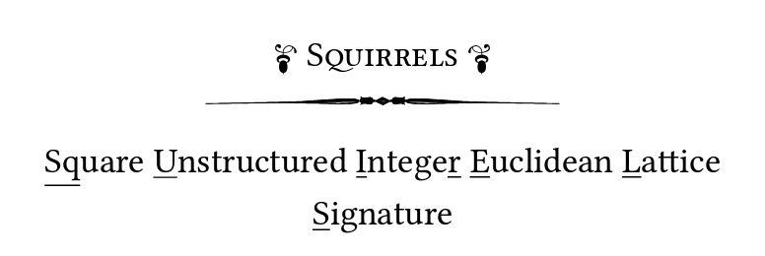
Intro
Current post-quantum cryptography faces uncertainties
Long-term viability of algebraically structured lattices uncertain
Plain lattice is the future
No more unnecessary additional algebraic structures
Conservative parameterizations to bolster security
Ensures robustness

Slide 3
Design Rationale
History
Main Mechanism
Squirrel Family

Slide 4
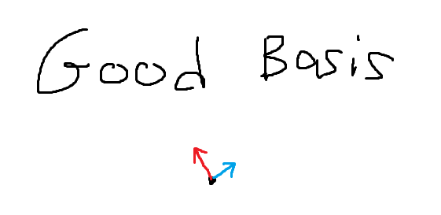
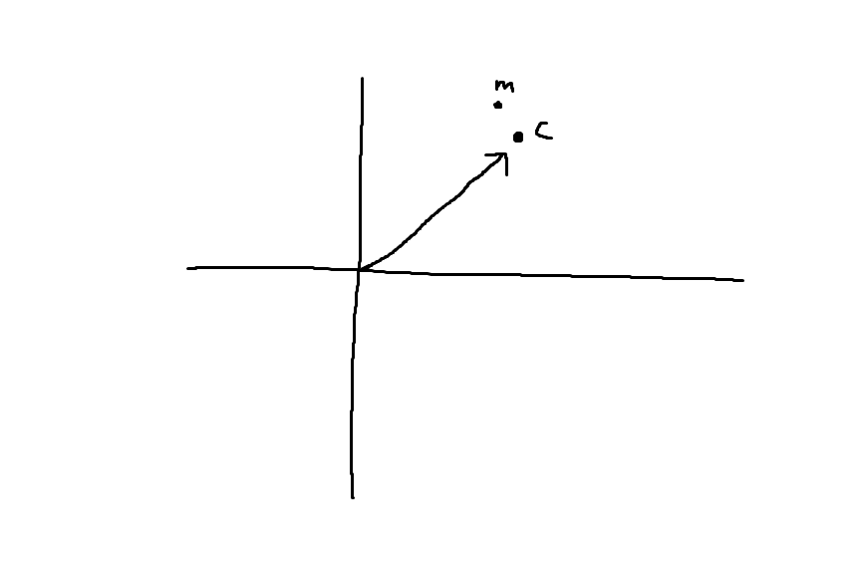
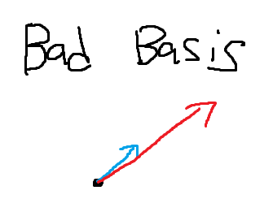
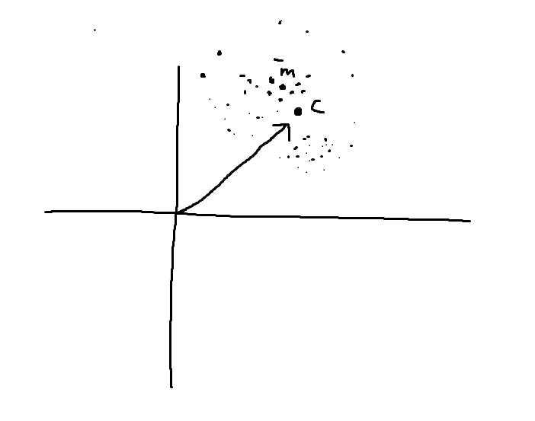
Main Mechanism
Uses GPV improvement of GGH
GGH (Goldreich-Goldwasser-Halevi signature)
Operation
Good vs. Bad Basis
Flaw
GPV Signature Scheme
Improvements
Key Components
Public Key
Secret Key
Hashing message
Signature generation

Slide 5
Squirrel Family
Construction & Reliance
Public and Secret keys
Key pair generation using public key
Signature Generation
Verification

Slide 6
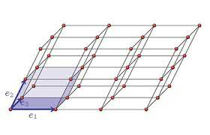
D 3.1 Advantages
Squirrel bases it’s security on generic lattice problems
It does not rely on lattices that do not have strong geometric properties
Lattices without strong geometric properties: Is more irregular and chaotic in its point distribution. This randomness and complexity make it more resistant to attacks
Lattices with strong geometric properties: Often have regular, easily discernible patterns, making them more vulnerable to certain types of attacks
Notes:
In lattice-based cryptography, when a lattice does not have strong geometric properties, it means that the lattice structure is not particularly well-ordered or predictable in terms of its geometric arrangement of points in the multi-dimensional space.
Lattices with strong geometric properties often have regular, easily discernible patterns, making them more vulnerable to certain types of attacks. When a lattice lacks strong geometric properties, it is more irregular and chaotic in its point distribution. This randomness and complexity make it more resistant to attacks, particularly those that rely on exploiting the lattice's geometric structure.
The use of lattices without strong geometric properties is a common practice in post-quantum cryptography because they are believed to provide better security against both classical and quantum computer-based attacks. This complexity and randomness make it challenging for attackers to find shortcuts or vulnerabilities in the lattice that would compromise the security of cryptographic systems based on it.

Slide 7
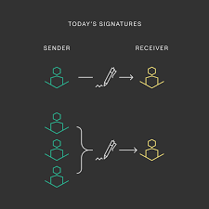
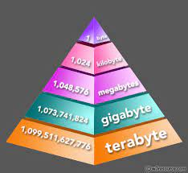
D 3.1 Advantages
Allows compact Signatures - Even though squirrels uses a complex problems it is still able to create small signatures.
The size of the signatures are in bytes similar to the Falcon and Dilithium signatures (These two signatures are well known methods for creating the smallest signatures in post-quantum world)

Slide 8

D 3.1 Advantages
Squirrel is competitive in terms of signature generation and verification efficiency
Even on a small laptop it is capable of generating several dozens to hundreds of signatures in a single second
Checking if a signature is valid is easy, SQUIRREL does a quick math equation in the form of a single linear equation
The process of verifying signatures is simple and straightforward without making the security less strong

Slide 9
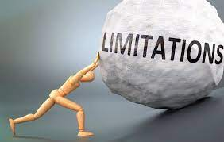
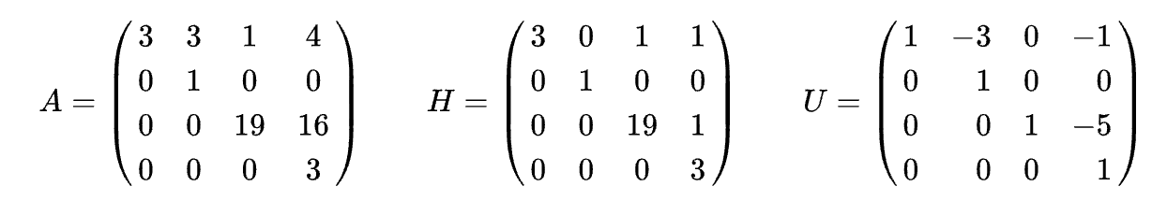
D 3.2 Limitations
With SQUIRRELS making keys takes time because of the complicated math involved with big matrices like calculating determinants and using something called the Hermite Normal Form.
HERMITE NORMAL FORM is used to simplify a matrix. Hermite Normal Form is equivalent to Row Echelon Form in linear algebra.
Notes:
Lattices and matrices are not the same.
Matrices: Think of them as organized grids of numbers, like spreadsheets. We use them for various math tasks like solving equations or transforming data.
Lattices: These are about points arranged in a multi-dimensional space. We use them for specific math problems and in cryptography. They are not grids of numbers but more like patterns of points.
In some cases, we can use matrices to represent data within a lattice, but the two ideas are different.

Slide 10

D 3.2 Limitations
Depending on how secure you want the keys it will take several seconds to just make 1 key pair but if you change keys often it can be a problem because SQUIRREL works with unstructured lattices so it takes more and more time as the lattice and gets bigger
Unstructured lattices have points arranged in a more random or irregular fashion within a multi-dimensional space. So it is believed to offer stronger security against attacks.
Notes:
Unstructured lattices and structured lattices differ in terms of their organization and properties:
Unstructured Lattices:
Random Arrangement: Unstructured lattices have points arranged in a more random or irregular fashion within a multi-dimensional space. There isn't a specific, well-defined pattern to the point arrangement.
Complexity: They are typically more complex and chaotic, which can make them difficult to analyze and work with mathematically.
Cryptography: Unstructured lattices are commonly used in lattice-based cryptography because their complexity is believed to offer stronger security against attacks, especially those based on quantum computers.
Structured Lattices:
Ordered Arrangement: Structured lattices, on the other hand, have a more ordered or regular arrangement of points. They often follow specific geometric patterns.
Predictability: Due to their regularity, structured lattices can be more predictable and have well-defined mathematical properties.
Applications: Structured lattices are used in various mathematical and computational applications, including certain types of coding theory and signal processing.
In summary, the key difference lies in the organization and regularity of the lattice structure. Unstructured lattices are more complex and less predictable, making them valuable for security in cryptography, while structured lattices have well-defined patterns and are used in various mathematical and computational contexts.
Certainly, let's look at some advantages and disadvantages of both unstructured and structured lattices in the context of cryptography:
Unstructured Lattices:
Advantages:
Security: Unstructured lattices are believed to offer a high level of security, especially against quantum attacks. The lack of predictable patterns makes them resistant to certain attacks.
Post-Quantum Cryptography: They are a popular choice in post-quantum cryptography because they provide a robust defense against quantum computing threats.
Disadvantages:
Efficiency: Unstructured lattices can be less efficient in terms of computation and key size. Operations on them may take longer, and the resulting keys can be large.
Complexity: Their complexity can make them challenging to work with and analyze. This may lead to increased implementation difficulties.
Structured Lattices:
Advantages:
Efficiency: Structured lattices can be more efficient for cryptographic operations. They often yield smaller key sizes and faster computations.
Predictability: The regular patterns in structured lattices can sometimes simplify analysis and implementation, making them easier to work with.
Disadvantages:
Security: Structured lattices may be more vulnerable to certain types of attacks compared to unstructured lattices. Predictable patterns can be exploited.
Quantum Vulnerability: They may not offer the same level of security against quantum attacks as unstructured lattices.
In summary, the choice between unstructured and structured lattices depends on the specific requirements of a cryptographic application. Unstructured lattices provide robust security but at the cost of efficiency and complexity, while structured lattices may be more efficient but potentially less secure against certain attacks, including those from quantum computers. Therefore, the trade-off between security and efficiency needs to be carefully considered when selecting the lattice type for a particular cryptographic scheme.

Slide 11

SVP - BKZ
Assess the problem
SVP (shortest vector problem)
Oracle SVP (Database)
Relies on BKZ algorithm
BKZ can access oracle
SVP
BKZ

Slide 12
Block Korkine-Zolotarev (BKZ) algorithm
Lattice Reduction
Purpose is to reduce the basis of a lattice.
Aim to transform this basis into a more "structured" form
More apparent properties.
Block Algorithm
Operates on a block of vectors at a time
Determines the number of vectors to be processed in each step
Efficiency and Complexity
Time complexity depends on the block size
Smaller block sizes are more efficient but provide weaker lattice reduction
Larger block sizes offer stronger reductions but require more computational resources

Slide 13

Attack
How an attack can be made
The Key Recovery Attack Aims at finding(at least) one the short vectors of the secrets basis from knowledge of the public key
lattice reduction on a public basis
Projection of such attack
Examines lattices formed by public basis
Finds vectors from secret basis by listing all possible vectors less than g min
Avoids listing all vectors by restricting search to a projection

Slide 14
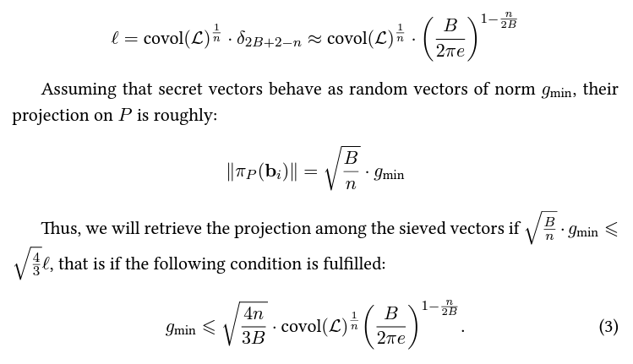
Cont.
More Precisely:

Slide 15

D 4.3 Hybridizing the Attack for sparse secrets
Sparse secrets are secret values or data that contain a lot of zeros or empty elements. These zeros can make certain types of attacks more difficult because the attack has to find the position of non-zero elements in the secret.
Notes:
The complement set of a set "I" contains all the elements that are not in set "I." In mathematical notation, if "I" is a subset of a larger set, let's say "A," then the complement set of "I" in relation to "A" is often denoted as "Ī" (pronounced "I bar") or sometimes as "A \ I" (where "" denotes set difference).
For example, if I = {1, 2, 3} and A = {1, 2, 3, 4, 5}, then the complement set of I in A is Ī = {4, 5}. These are all the elements in A that are not in I.
Adding on to attacks
Intro ducting sparse secrets

Slide 16
D 4.3 Hybridizing the Attack for sparse secrets
A good guess is the only thing we need to search for secret keys outside these positions by intersecting the public lattice with the complement set of I.
To hybridize the attack there are two main components.
Guessing Sparse Vector: You guess the positions of zeros in a sparse vector within the lattice. When you guess correctly, it reduces the search space.
Lattice Reduction: You then apply lattice reduction on the reduced lattice, which is faster because it's smaller. Lattice reduction transforms the basis of the lattice into a more structured form, making it easier to find shorter vectors.
Hybridizing these strategies makes the attack more efficient.
Notes:
The complement set of a set "I" contains all the elements that are not in set "I." In mathematical notation, if "I" is a subset of a larger set, let's say "A," then the complement set of "I" in relation to "A" is often denoted as "Ī" (pronounced "I bar") or sometimes as "A \ I" (where "" denotes set difference).
For example, if I = {1, 2, 3} and A = {1, 2, 3, 4, 5}, then the complement set of I in A is Ī = {4, 5}. These are all the elements in A that are not in I.

Slide 17
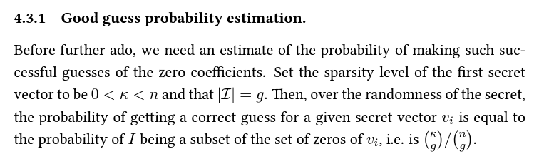
D 4.3.1 Good Guess probability estimation
This expression is used to estimate the probability of successful guesses of the zero coefficients

Slide 18
D 4.3.1 Putting it all together
Attack Strategy
While a secret vector remains undiscovered:
(a) Randomly guess the positions I ⊂ {1, ..., n} of g zeros.
(b) Compute the lattice L' = L ∩ Z̄I.
(c) Reduce L' using the BKZ (Block Korkine-Zolotarev) Algorithim.
(d) List all vectors with a length smaller than 4/3 times the norm of the Gram-Schmidt vector ˜bi, which is the (−B)-th Gram-Schmidt vector of the basis obtained in step (c).
(e) For each such vector, lift it as a vector of L' using Babai's nearest plane algorithm and check if it is shorter than gmax, then return it."
This method describes how to recover a secret vector from a lattice

Slide 19
D 4.4 Additional Security Properties
There are extra security features are called BUFF properties
This BUFF feature called “message bound signatures”.
Message bound signatures is a feature that ties a digital signature to a specific message making it so the signature only applies to that message
Advantages
Signature Uniqueness
Message Integrity
Prevents Reuse
Useful for Verification

Slide 20

Private Key
The private key is a matrix of size n × n, each row is a vector of B
Must follow these 3 requirements:
Vectors in B must have norms within the bounds defined by g-min and g-max, ensuring they are neither too small & too large.
det(B) = ∆, vector norm value
Used as a security parameter
The private key matrix B is co-cyclic
Leads to faster matrix-vector multiplications

Slide 21

Public Key
Starts with value called “vector check”
The formula performs modulo operations on various prime numbers from P
“i” , last vectors, iterates through the values from 1 to n - 1
For each value of "i," the modulo operation is performed, resulting in finding the public key.

Slide 22
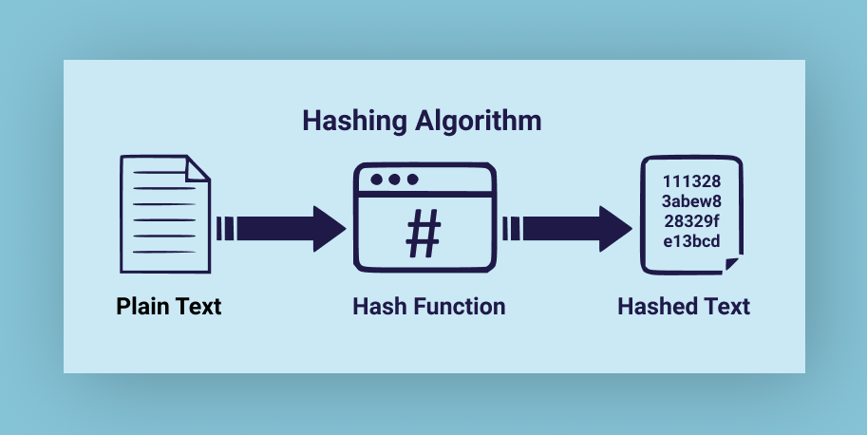
Hash-and-Sign Signature Scheme
Messages are hashed before signing and verifying signatures
In Squirrels, messages get hashed to become a vector
The hash function that is used is called “HashToPoint”
The function converts the message into a vector, turning parts of the hashed message into numbers that fall in a certain range

Slide 23

Signature Generation
The message "m" is hashed, along with a salt value "r," resulting in a point "h."
“Salt Value” is a random value that is used to enhance the security and uniqueness of the signature
Squirrels then uses Klein's trapdoor sampler to identify a lattice point that is in close proximity to "h."

Slide 24

Signature Verification
First, we recalculate the hash point, "h", using the original message, "m", and salt, "r," HashToPoint does this
Next, we check to see that the signature "s" is within the expected range.
The final step involves using the public key to verify that the sum of the signature "s" and the hash point, ‘h’, (s + h), is part of the lattice structure.
This step confirms the signature's accuracy and its association with the original message.

Slide 25
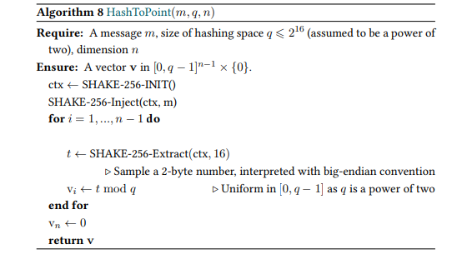
HashToPoint Function

Slide 26
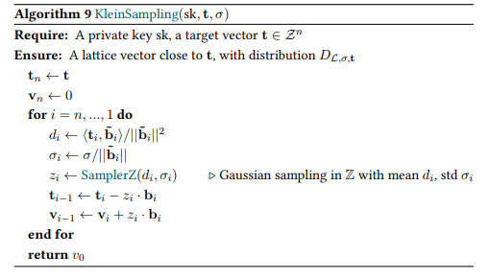
Klein Trapdoor Sampler

Slide 27
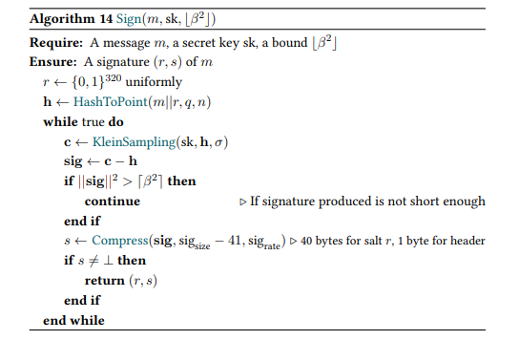
Sign Algorithm

Slide 28
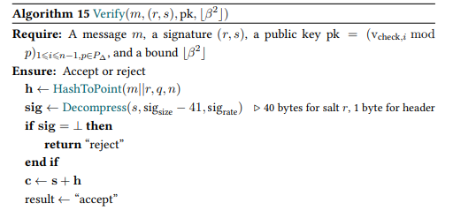
Verify Algorithm

